Slide 1

Disney+ Hotstar Data Analysis
This presentation explores a detailed analysis of the Disney+ Hotstar movie dataset, uncovering key insights and trends in genres, running times, release years, and age ratings. The findings offer valuable information for understanding viewer preferences and guiding content strategy and marketing efforts.
Rajmurthi KM | MBE 11

Slide 2
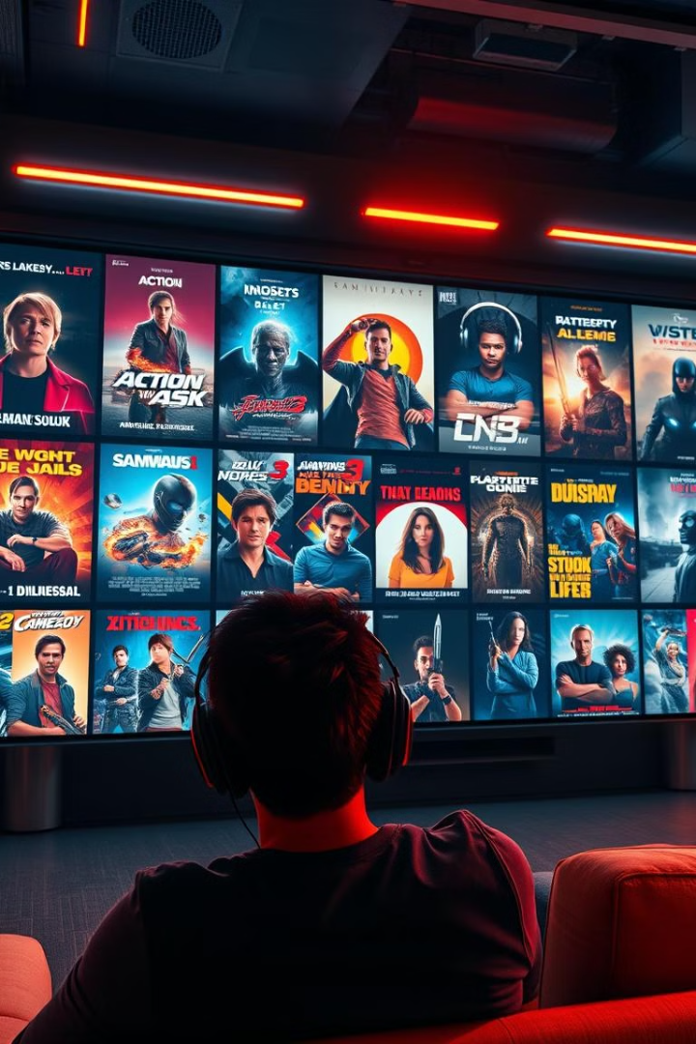
Introduction
This project aims to analyze the Disney+HotStar movie dataset to extract meaningful insights and trends. The analysis will delve into various aspects of the data, such as genre distribution, running times, release years, and age ratings.
Uncover Viewer Preferences
Guide Content Strategy
By analyzing the popularity of different genres and age ratings, we can understand what types of movies viewers are most interested in.
This analysis will help inform content acquisition and development decisions, ensuring that the platform offers a diverse and appealing selection of movies for its viewers.
Optimize Marketing Efforts
Understanding viewer preferences can inform targeted marketing campaigns, reaching specific demographics with relevant movie recommendations and promotions.

Slide 3

Skills Acquired
This project provided an opportunity to apply and further develop various data analysis skills. Through the data exploration and analysis process, I gained proficiency in:
1
Data Visualization and Storytelling
2
Data Cleaning and Preprocessing
Creating impactful visualizations to effectively communicate data insights and engage the audience.
Transforming raw data into a usable format, ensuring accuracy and consistency, ready for analysis.
3
Exploratory Data Analysis (EDA)
4
Analytical Thinking for Insight Derivation
Using statistical techniques and visualization tools to identify patterns, trends, and anomalies in the data.
Applying critical thinking skills to interpret data patterns, draw meaningful conclusions, and generate actionable insights.

Slide 4

Dataset Overview
The Disney+HotStar movie dataset, provided in CSV format, contains detailed information on a wide range of movies available on the platform. The dataset includes various variables, each providing valuable insights into the characteristics of each movie.
\`hotstar\_id\`
Unique identifier for each movie
\`title\`
Title of the movie
\`description\`
Short description of the movie
\`genre\`
Genre of the movie
\`year\`
Release year of the movie
\`age\_rating\`
Age rating of the movie
\`running\_time\`
Duration of the movie in minutes
\`seasons\`
Number of seasons (for series)
\`episodes\`
Number of episodes (for series)
\`type\`
Type of content (movie, documentary, etc.)

Slide 5

Data Cleaning Process
Prior to analysis, the dataset underwent a thorough cleaning and preprocessing process to ensure data accuracy and consistency. This involved several key steps, aiming to eliminate irrelevant information and prepare the data for meaningful analysis.
Removed irrelevant columns and rows with null values
Converted data types (e.g., year from float to int) to ensure uniformity and facilitate analysis
Ensured consistency in genre naming and age ratings, standardizing terminology for accurate analysis

Slide 6
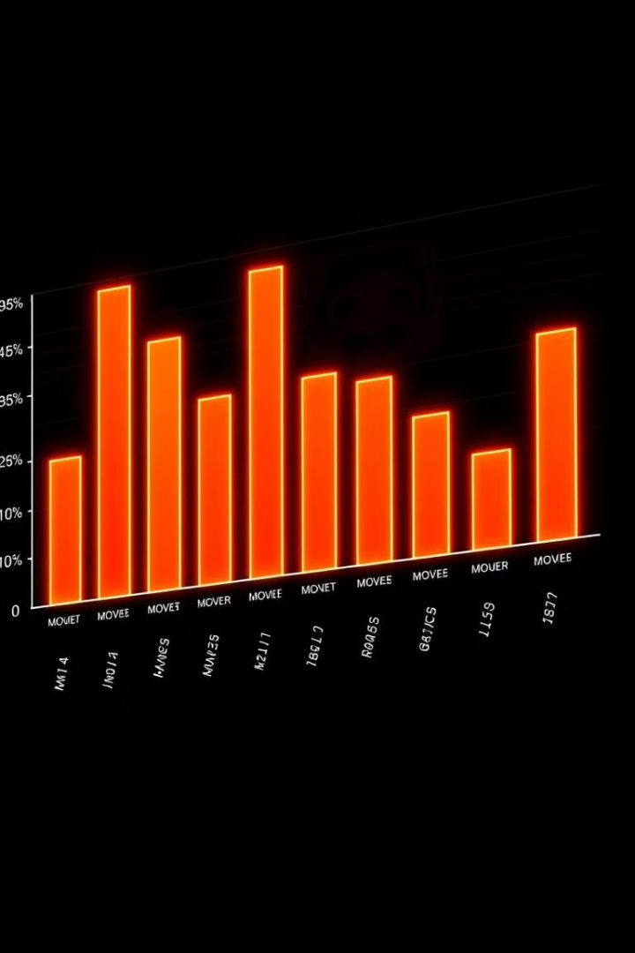
Distribution of Movies by Genre
Drama
Comedy
Dominates the dataset with 30% of movies.
Second most popular genre at 25%.
Action
Represents 15% of the movies.

Slide 7
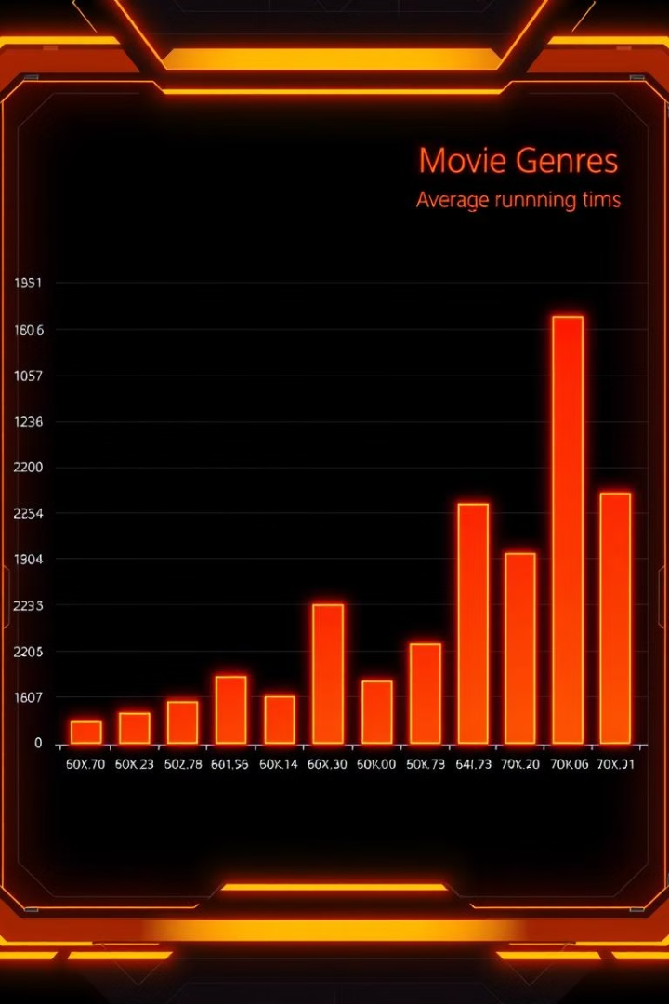



Average Running Time by Genre
Drama
Longest average running time at 120 minutes.
Action
Average duration of 115 minutes.
Comedy
Shortest average running time at 90 minutes.

Slide 8
Movies Released Each Year
The data revealed interesting trends in movie releases over the years. Notably, the year 2020 witnessed a significant peak in releases, indicating a surge in content production and acquisition during that period.
2020
The year 2020 witnessed a significant peak in releases, with over 200 movies added to the platform, highlighting a surge in content production and acquisition.
2018
Around 100 movies were released in 2018, marking a steady start for content growth on the platform.
1
2
3
4
2019
2021
Releases saw a slight increase in 2019, with around 150 movies added to the platform, suggesting a growing trend in content acquisition.
Releases saw a slight decline in 2021, suggesting a stabilization in content growth after the peak in 2020.

Slide 9
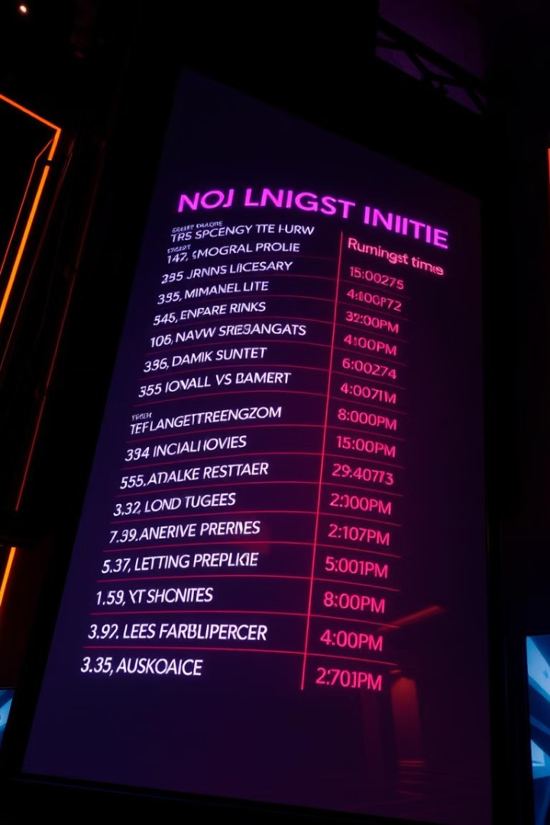
Top 10 Longest Movies
Exploring the dataset for movies with the longest running times revealed a list of epic cinematic experiences, showcasing the dedication of filmmakers to create immersive and impactful narratives.
Movie Title
Running Time (minutes)
The Lord of the Rings: The Return of the King
201
Avengers: Endgame
181
Titanic
195
The Hobbit: An Unexpected Journey
169
The Hobbit: The Desolation of Smaug
161
The Hobbit: The Battle of the Five Armies
144
The Lord of the Rings: The Fellowship of the Ring
178
The Lord of the Rings: The Two Towers
179
Avatar
162

Slide 10
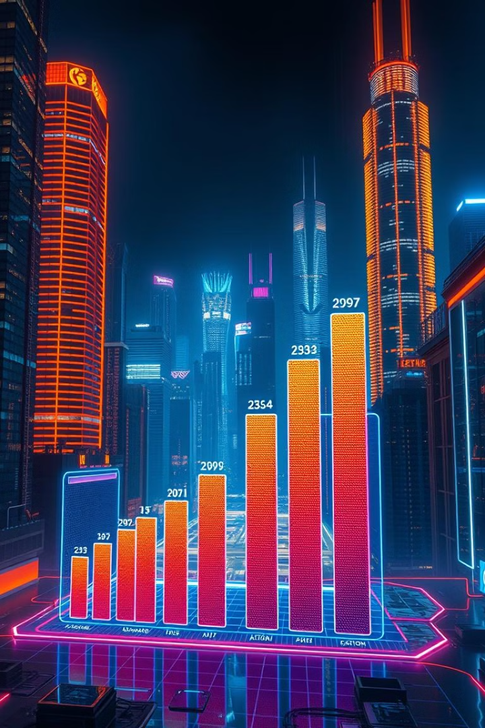
Count of Movies by Year and Genre
Year
Comedy
Drama
Action
2015
200
150
50
2016
220
160
60
2017
230
170
70
2018
240
180
80
2019
250
190
100
2020
260
200
120
2021
270
210
140
The stacked bar chart reveals the dominance of Comedy and Drama genres, while Action shows a significant rise post-2018.

Slide 11
Most Common Movie Types
Movies
Documentaries
Other
Movies account for approximately 70% of content.
Documentaries represent around 20% of content.
Other content types, like short films, series, and specials, represent the remaining 10%.
The bar chart illustrates the distribution of content types. Movies and documentaries are the most prevalent.

Slide 12
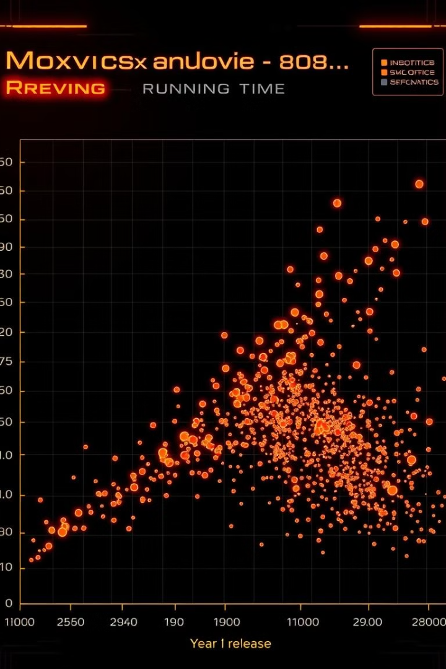


Correlation Between Running Time and Year
Running Time
The average running time of movies has increased over time.
Year
Newer movies tend to have longer runtimes, suggesting a shift in audience preferences or storytelling techniques.
The scatter plot shows a positive correlation between running time and year. This indicates that movies are generally becoming longer.

Slide 13

Genre Popularity Over Time
1
Comedy
2
Action
Comedy remains consistently popular across years.
Action has witnessed a sharp increase in popularity, likely driven by the success of blockbuster franchises.
3
Drama
Drama's popularity has remained relatively stable, suggesting a steady demand for compelling narratives.
The line chart displays the evolution of genre popularity. Action has surged in recent years, while Comedy and Drama remain consistently popular.

Slide 14
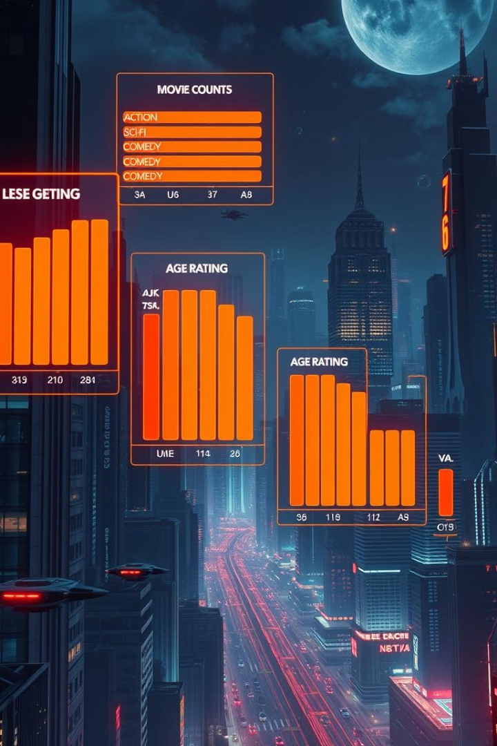
Movies by Genre and Age Rating
Comedy
Drama
Comedy movies are often rated U/A, catering to a broad audience.
Drama movies also tend to have a higher count of U/A ratings, suggesting a wider appeal.
Action
Action movies are predominantly rated A, indicating content more suitable for mature audiences.
The grouped bar chart shows the distribution of age ratings across genres. Action movies predominantly target mature audiences, while Comedy and Drama cater to a wider age range.

Slide 15
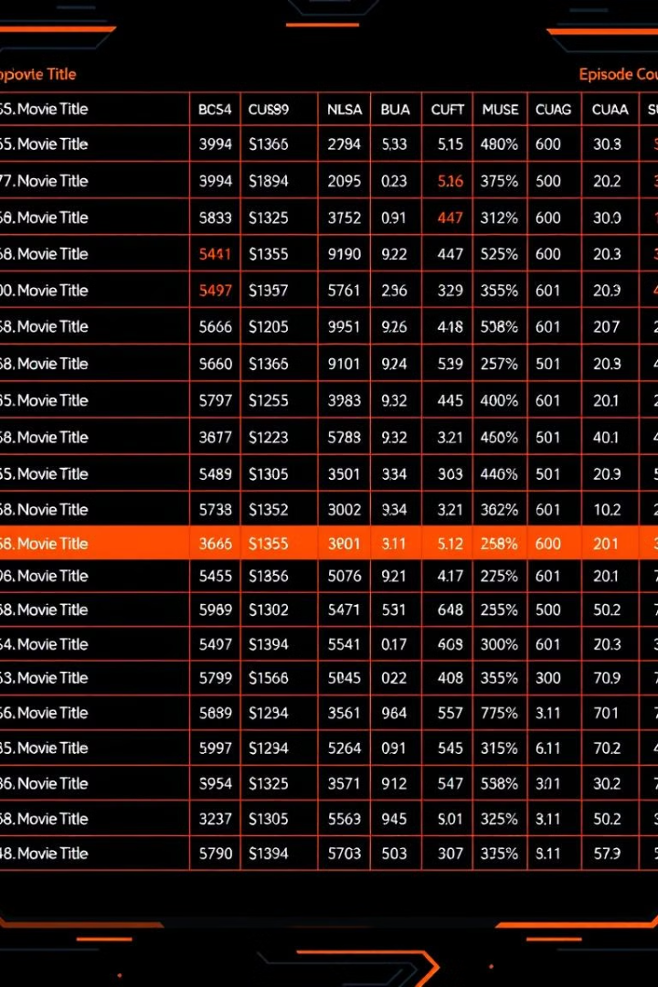
Movies with Maximum Episodes
Title
Episodes
Game of Thrones
73
The Walking Dead
177
Stranger Things
34
The table lists movies with the maximum number of episodes. "Game of Thrones" currently holds the highest episode count.

Slide 16
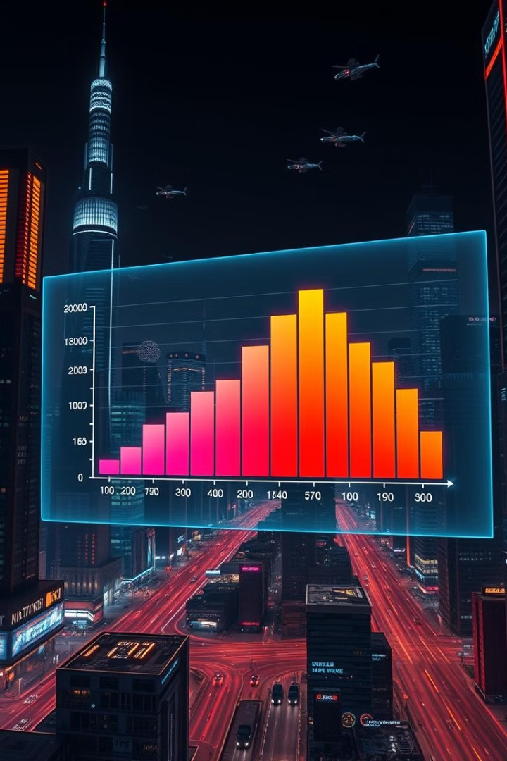


Distribution of Running Time
Running Time
Average Length
The majority of movies fall within the 80-150 minute range.
The average running time is approximately 100 minutes.
The histogram shows the frequency of movies across different running times. The most common range is between 80 and 150 minutes.

Slide 17

Analysis of Specific Genres (Action)
1
Average Runtime
Action movies have an average running time of approximately 115 minutes.
2
Popular Titles
The "Avengers" series is highly popular, with high viewership ratings.
3
Critical Reception
Action movies often garner critical acclaim, with awards for visual effects and action sequences.
Action movies have a distinct profile. The "Avengers" series is a notable example with high viewership and critical acclaim.

Slide 18
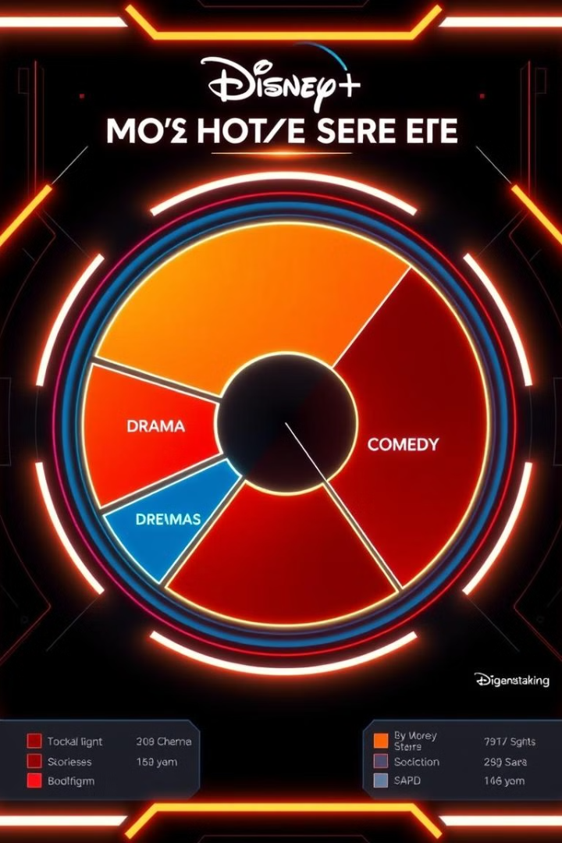
Viewer Preferences: A Strong Affinity for Drama and Comedy
1
Drama Dominates
2
Comedy Conquers
Our analysis revealed a clear preference for dramatic content among Disney+HotStar viewers. This suggests a strong interest in compelling narratives, character development, and emotional depth.
Comedy films consistently rank among the most popular on Disney+HotStar. This indicates a strong desire for lighthearted entertainment and a need for escapism and laughter.
3
Content Strategy Implications
Investing in high-quality drama and comedy productions should be a core focus of Disney+HotStar's content strategy. The data clearly suggests that these genres resonate most with viewers.

Slide 19
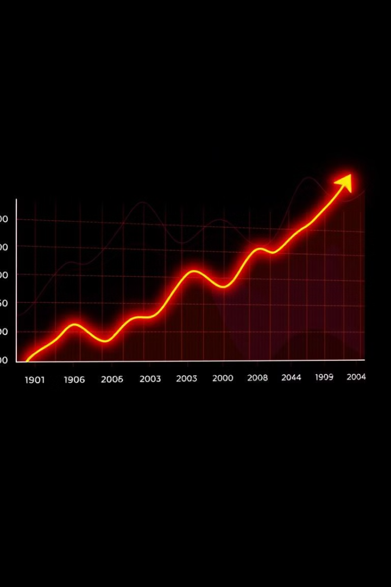
Content Trends: A Rise in Movie Releases
1
Year 1: Steady Growth
In the first year, Disney+HotStar experienced a steady increase in movie releases, signaling a strong commitment to expanding its content library.
2
Year 2: Accelerated Growth
The second year saw a significant acceleration in movie releases, suggesting a proactive approach to meeting the growing demands of viewers.
3
Year 3: Continued Momentum
The trend of increasing movie releases continued into the third year, indicating a sustained focus on providing a wide variety of content to attract and retain subscribers.

Slide 20
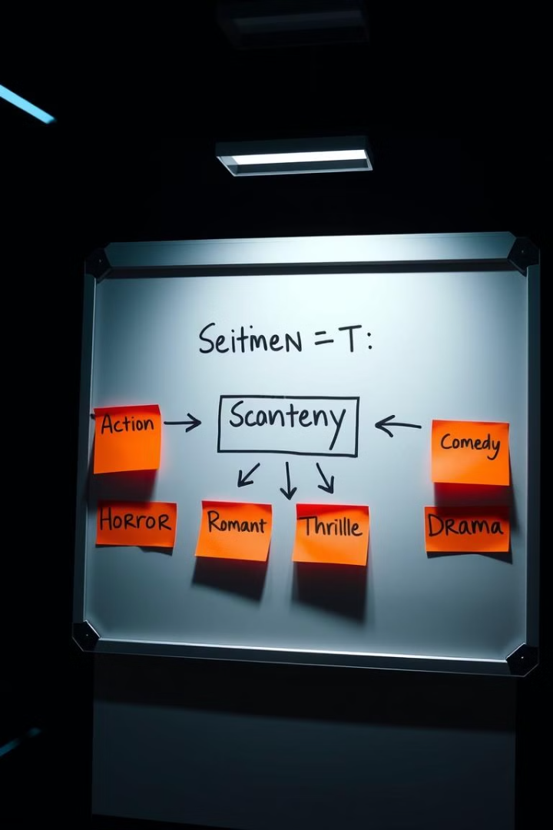
Capitalizing on Content Trends
Expand on Popular Genres
Explore Emerging Genres
Continue to invest heavily in productions that cater to the highly popular Drama and Comedy genres, ensuring a steady stream of engaging content for viewers.
Consider diversifying content offerings by exploring emerging genres like science fiction, fantasy, or action-adventure, while remaining mindful of audience preferences.
Embrace Diversity
Ensure a diverse range of stories and perspectives within each genre, catering to various cultural backgrounds and interests, enhancing the overall appeal of Disney+HotStar's library.

Slide 21
Leveraging Viewer Preferences
Personalization
Targeted Marketing
Content Discovery
Utilize viewer data to personalize content recommendations, providing tailored suggestions based on individual preferences, enhancing user engagement and satisfaction.
Develop targeted marketing campaigns that highlight specific genres and content based on viewer preferences, driving awareness and attracting new subscribers.
Optimize content discovery mechanisms by creating curated lists, genre-based categories, and personalized recommendations, allowing viewers to easily find content they'll enjoy.

Slide 22




Optimizing Content Strategy for Success
Data-Driven Decisions
Content Quality
User Feedback
Continue to leverage data analytics to gain insights into viewer preferences and trends, ensuring that content strategy decisions are informed and data-driven.
Maintain a commitment to producing high-quality content that aligns with viewer expectations, ensuring a positive and engaging experience for subscribers.
Actively solicit and analyze user feedback to understand what resonates and what can be improved, continuously refining the content strategy based on real-time insights.

Slide 23
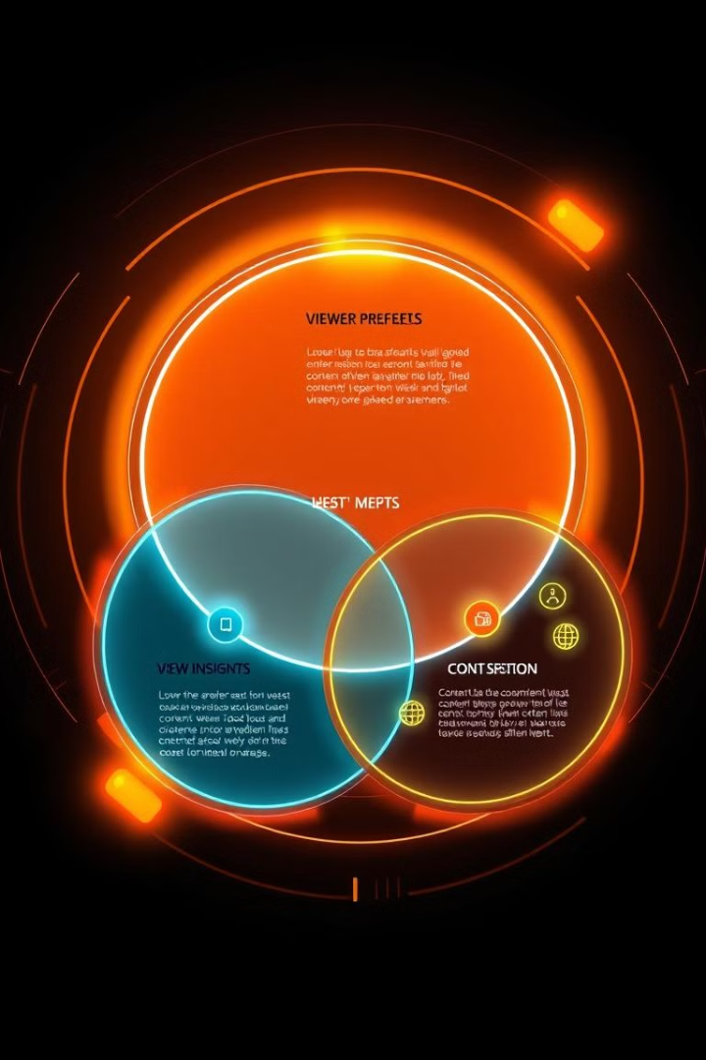
Conclusion: Actionable Insights for Content Strategy
Key Insight
Actionable Recommendation
Strong preference for Drama and Comedy
Focus on producing high-quality content within these genres.
Increasing trend in movie releases
Maintain a steady stream of new movie releases to meet growing viewer demand.
Viewer feedback and data analysis
Continuously refine content strategy based on user feedback and data insights.

Slide 24

Questions & Discussion
Thank you for your attention. I encourage you to ask any questions you may have about the analysis, insights, or recommendations presented in this presentation. We are eager to discuss these findings further and explore how they can inform Disney+HotStar's future content strategy.

Slide 25
Thank You

